Slide 1









Customer Churn Analysis & Business Diagnostics
Brazilian E-Commerce Platform
Project Overview
Business Impact
Comprehensive analysis of customer churn patterns
Low repeat purchase rate (3.12%)
Identification of key business risk factors
Delivery delays affecting customer satisfaction
Data-driven recommendations for improvement
High freight costs impacting loyalty
Dataset Scope
Key Findings
100,000+ orders processed
Delivery performance strongly correlates with churn
Time period: 2016-2018
Geographic regions show varying churn risk
Multiple touchpoints: customers, orders, products, logistics
Operational efficiency directly impacts customer relationships
Prepared by: Deepak Malviya
Report Date: 2025-12-17
Data Analyst Intern

Slide 2


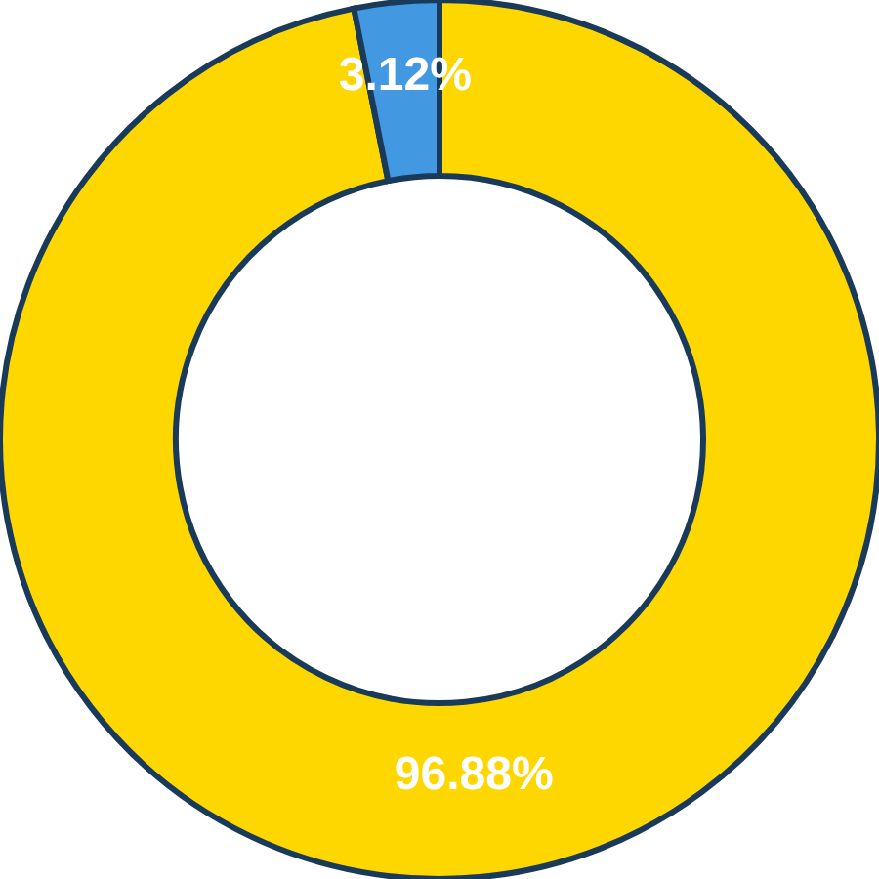


Why Customer Churn Is a Critical Business Risk
E-commerce Churn Definition
Customer churn represents lost revenue stability and growth potential, directly impacting the platform's ability to scale sustainably.
Revenue Impact
Each lost customer represents not just immediate revenue loss but also the future lifetime value of that relationship.
Urgency for Retention Strategy
Transitioning from a "one-and-done" business model to one that fosters customer loyalty is critical for long-term growth.
One-time Buyer Dominance: 96.88%
Critical need to convert one-time customers into repeat buyers
Key Insight
The Brazilian E-Commerce Platform operates with a dangerously high churn rate, indicating fundamental issues in customer retention. Immediate action is required to understand and address the root causes of customer departure.
Prepared by: Deepak Malviya, Data Analyst Intern
Page 2 of 10

Slide 3


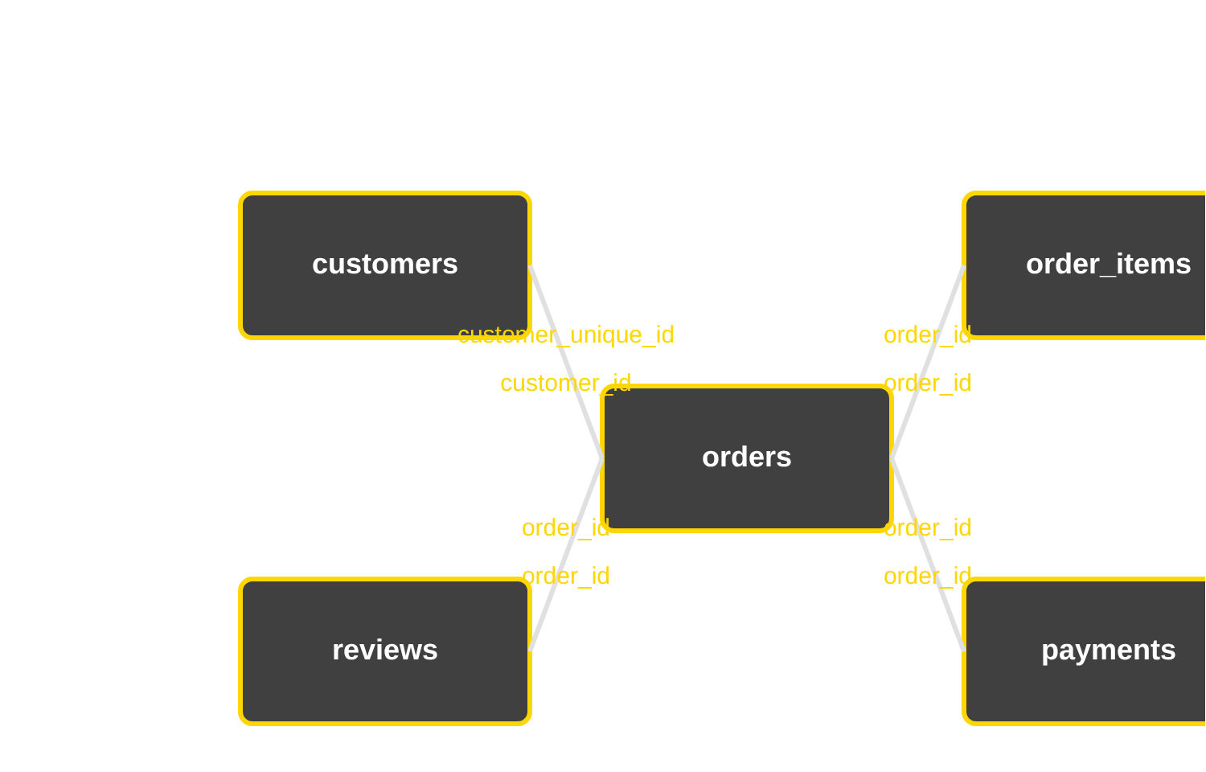


Data Foundation & Analytical Readiness
Dataset Overview
Relational Structure & Data Architecture
Brazilian e-commerce dataset with orders (2016-2018), containing customer interactions and transaction details.
Key Tables
customers: User demographic data
orders: Transaction timestamps, status
order_items: Products, pricing, sellers
payments: Methods, installments
reviews: Ratings, comments, dates
SQL Methodology
Complex joins and CTEs used to create Analytics Base Table (ABT) for churn analysis and feature engineering.
Key Relationships:
customer_unique_id: Aggregates customer lifetime behavior
order_id: Central key linking order details, items, payments, and reviews
Prepared by: Deepak Malviya, Data Analyst Intern
Page 3 of 10

Slide 4

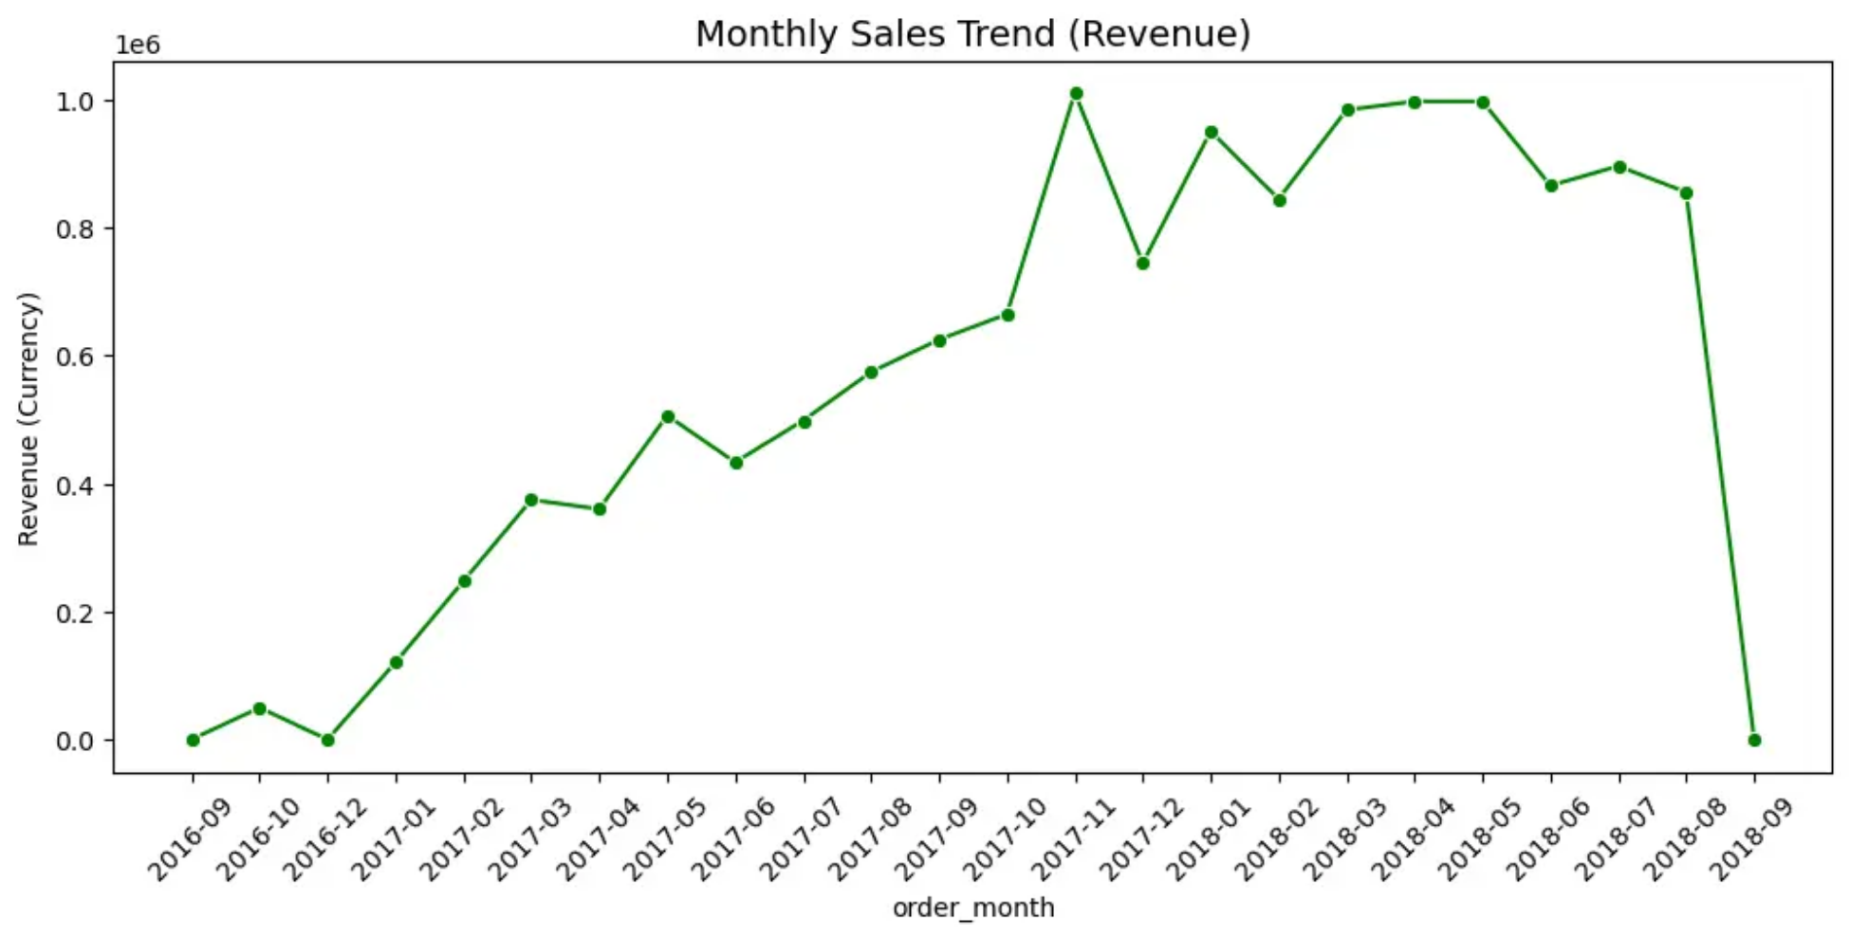


Revenue Growth with Strong Seasonality
Growth Trajectory
Consistent upward trend in monthly revenue from September 2016 to September 2018, with notable acceleration during peak periods.
Seasonal Patterns
Significant revenue spikes during specific months, likely corresponding to major sales events and holiday seasons (Black Friday, Christmas).
Business Implications
Requires strategic inventory planning to prevent stockouts during peak demand periods. Marketing efforts should be timed to leverage these seasonal windows.
Key Insight
While overall growth is positive, the pronounced seasonality necessitates adjusted inventory planning and targeted marketing strategies to capitalize on peak periods and smooth out revenue fluctuations.
Prepared by: Deepak Malviya, Data Analyst Intern
Page 4 of 10

Slide 5


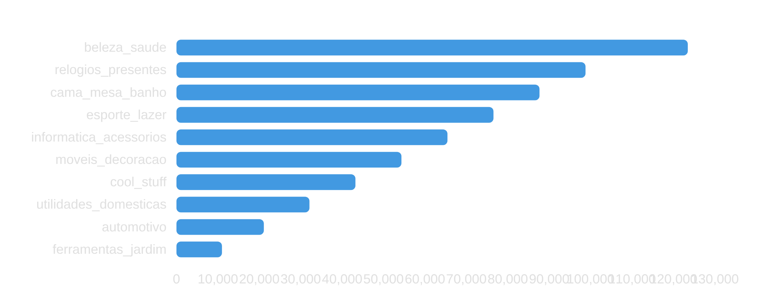


Revenue Concentration & Category Performance
Top 10 Product Categories by Revenue
High-Value Customer Risk
Concentration of revenue among top customers creates vulnerability. VIP customers require dedicated attention to mitigate risk of loss.
Growth Opportunities
Category-level insights can inform product development and marketing strategies to diversify revenue streams.
Key Insight
Revenue concentration in specific categories suggests opportunity for targeted growth strategies. Categories like "beleza_saude" and "relogios_presentes" show exceptional performance and could be expanded through enhanced marketing or product development.
Prepared by: Deepak Malviya, Data Analyst Intern
Page 5 of 10

Slide 6


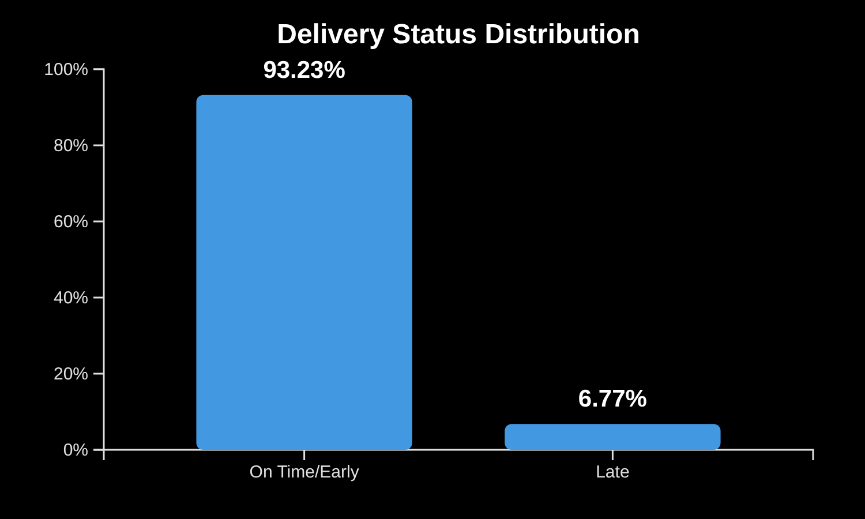



Delivery Delays as a Customer Experience Risk
Delivery Performance
On-Time vs. Late Deliveries
6.77% of orders are delayed, indicating potential operational reliability issues that directly impact customer experience.
Operational Reliability
Logistics performance is a critical factor influencing customer satisfaction and retention rates.
Customer Impact
Late deliveries erode trust and lead to customer dissatisfaction, increasing the likelihood of churn.
On Time/Early: 93.23%
Late: 6.77%
Key Insight
Delivery estimation accuracy is strongly correlated with churn. Improving logistics performance can directly enhance customer relationships and reduce churn risk.
Prepared by: Deepak Malviya, Data Analyst Intern
Page 6 of 10

Slide 7


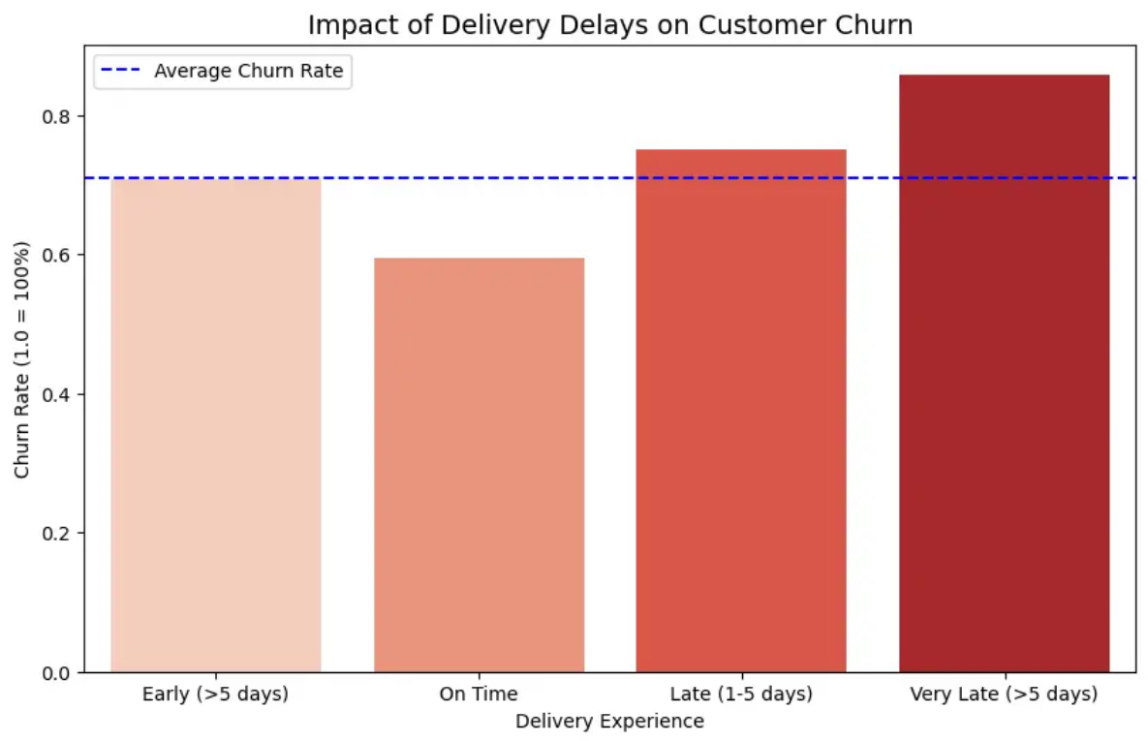

Late Deliveries Directly Drive Customer Churn
Key Insights
Impact of Delivery Delays on Customer Churn
Customers experiencing late deliveries exhibit significantly higher churn rates
"Very Late" deliveries lead to the highest churn, confirming operational efficiency as a marketing tool
Delivery experience strongly correlates with customer satisfaction and loyalty
Predictable delays burn customer relationships, highlighting the need for proactive management
Churn rate increases progressively with delivery delays
Business Recommendation
Implement an "Apology Protocol" for predicted delays to proactively manage customer expectations. This turns a negative experience into an opportunity for recovery while maintaining the relationship.
Prepared by: Deepak Malviya, Data Analyst Intern
Page 7 of 10

Slide 8


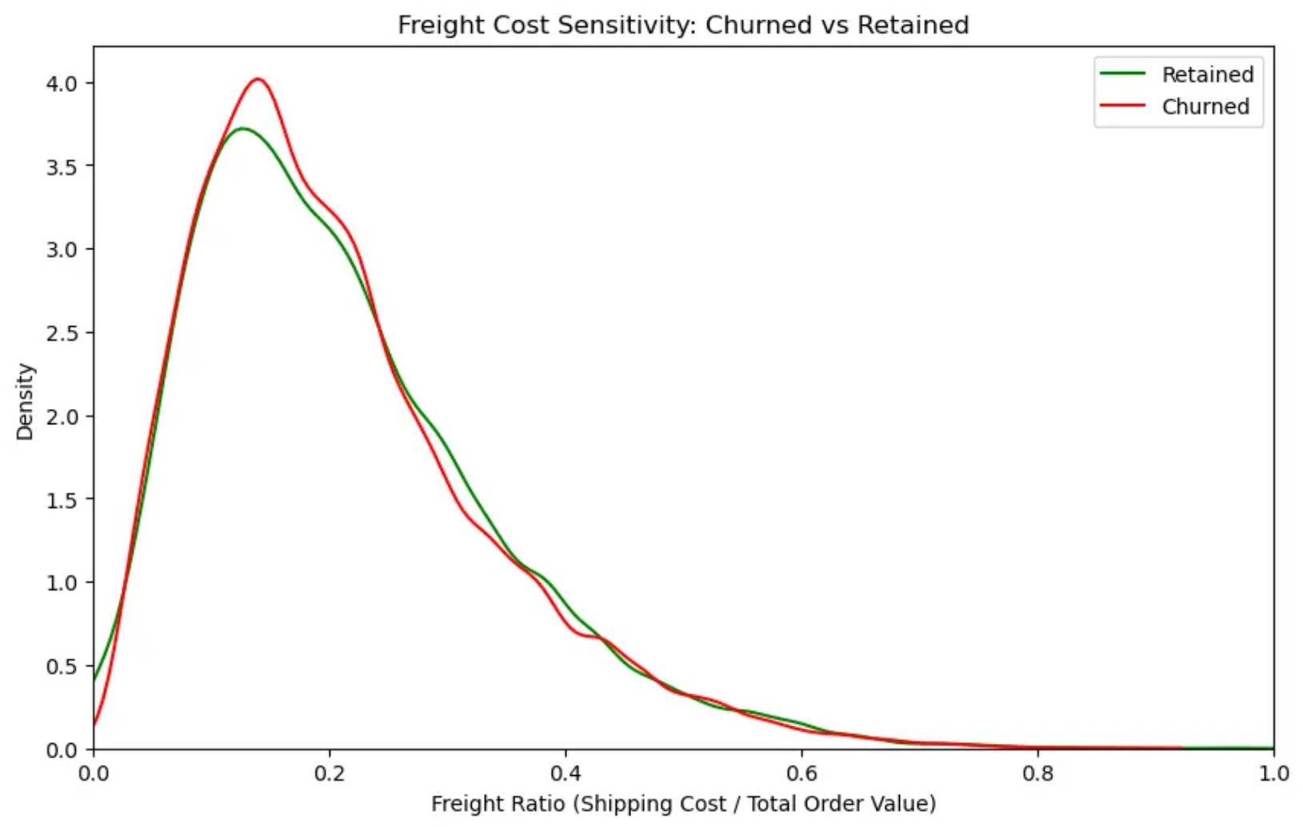

High Shipping Costs Kill Customer Loyalty
"Sticker Shock" Effect
High shipping costs, particularly for low-value items, create a "sticker shock" effect that destroys customer loyalty and trust.
Freight Ratio Analysis
Churned customers experienced higher freight ratios compared to retained customers, indicating shipping costs were a key factor in their decision to leave.
Key Insight
The density of churned customers peaks at higher freight ratios, showing that customers are particularly sensitive to shipping costs when making purchasing decisions.
Figure 1: Freight Cost Sensitivity - Retained vs Churned Customers
Density plot showing higher freight ratios for churned customers
Action Plan
Negotiate better rates for lightweight/low-value items
Implement a minimum cart value for free shipping
Prepared by: Deepak Malviya, Data Analyst Intern
Page 8 of 10

Slide 9


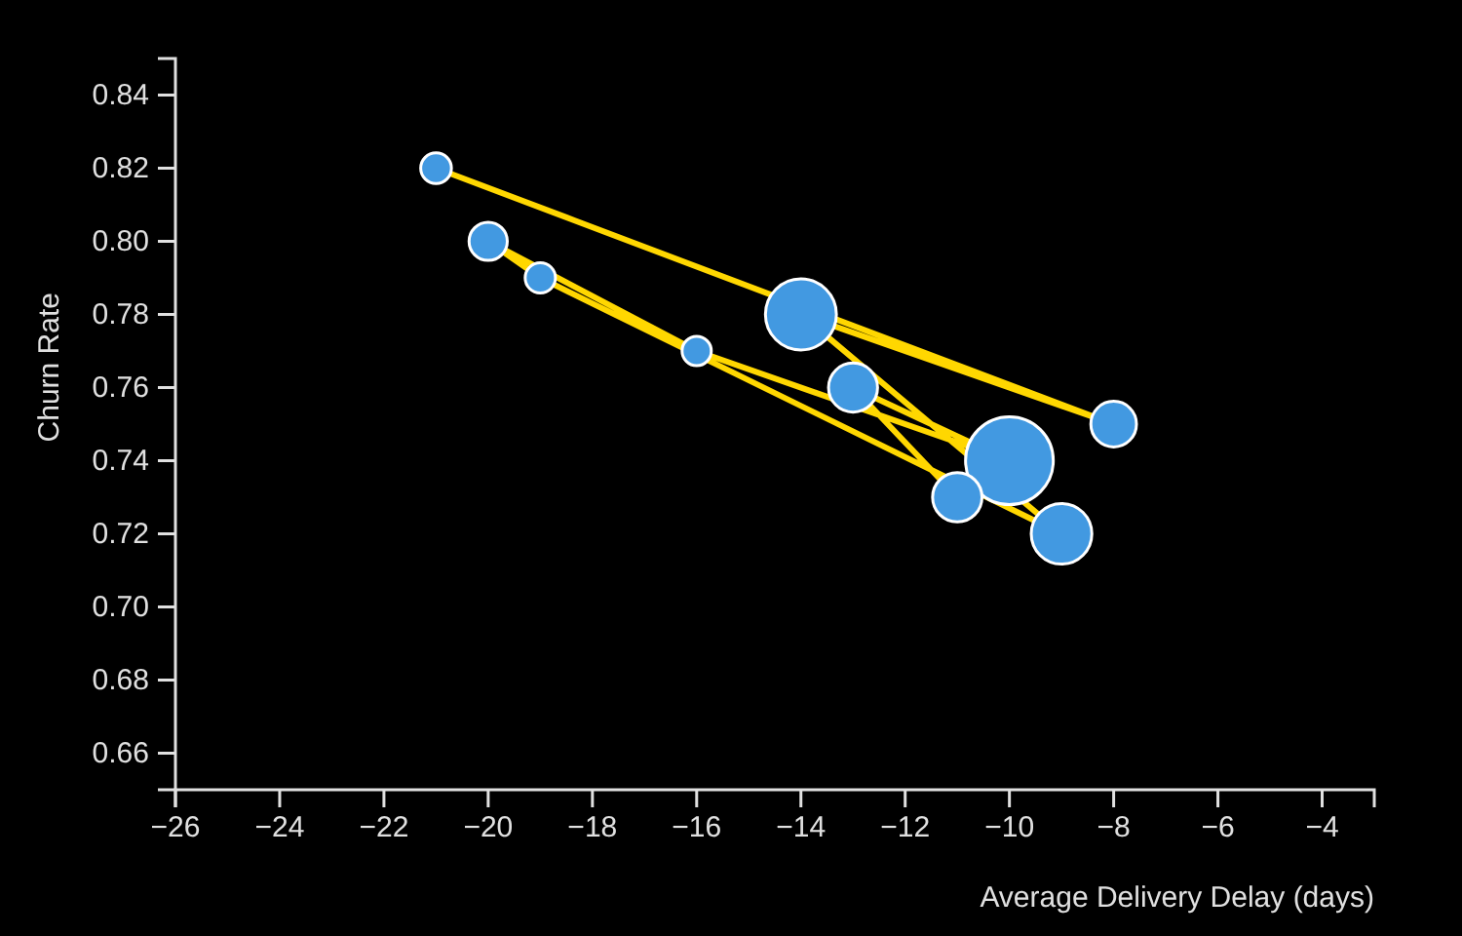

Regional Logistics Failures Increase Churn
High-Risk Regions
Churn Rate vs. Average Delivery Delay by State
States like the North/Northeast (AC, RO, RR) show higher churn rates, indicating regional logistics failures as a significant driver.
Logistics Partner Dependency
Quality of logistics partners in specific states directly impacts customer experience and retention rates.
Critical Threshold
States with average delivery delays exceeding 5 days show significantly higher churn rates, suggesting a threshold effect.
Key Insight
Geographic location serves as a proxy for service quality, with regions like the North/Northeast experiencing higher churn due to failing logistics partners. Immediate action is required to improve delivery performance.
Prepared by: Deepak Malviya, Data Analyst Intern
Page 9 of 10

Slide 10
















Actionable Business Recommendations
Fix Logistics Partners
Reduce Freight Ratio
Proactive Recovery
Regional Strategy
Retention Focus
Switch carriers in bottom 5 performing states with high delay rates
Absorb shipping for low-value items or implement minimum cart value
Implement "Apology Protocol" with 10% vouchers for predicted delays
Stop acquisition in states with average delivery delays >5 days
Develop loyalty programs to increase repeat purchase rate from 3.12%
Business Value Delivered & Next Steps
Reduced customer churn rates
Reallocated resources to profitable areas
Increased customer lifetime value
Implemented monitoring KPIs
Improved operational efficiency
Continuous strategy refinement
Prepared by: Deepak Malviya, Data Analyst Intern
Page 10 of 10

